Slide 1
ENGINEERING COUTURE
EMBEDDED SYSTEMS DESIGN
SYAMIM AZLAN
1425772
Notes:
Hello and Assalamualaikum. My name is Syamim.
Mention about recording the session for assignment, it’s a 10 minutes session hopefully
Preferable if there’s some impromptu questions regarding engineering in general, will try my best to answer it, but if there’s none, then that’s fine

Slide 2
INTRODUCTION
MECHATRONICS ENGINEERING IN IIUM
Notes:
Mechatronics Engineering in an interdisciplinary engineering, where it is available in IIUM since it was established back in 1994. It is Bachelor of Science in Engineering rather than Engineering Technology degree.
ESC is more towards advanced theories and concepts, but not much on hands-on practices.
Technology Engineering is more towards hands-on practices.
What’s different? Our classes and courses.
Right now, this course of Embedded Systems Design is among the hands-on classes that we have. It’s cool to

Slide 3
01
WHERE CAN YOU GO?
02
WORKLOAD?
03
MARKET & COMPETITION?
04
REAL-LIFE APPLICATION?
IT, cars, airplanes.
Studies? Workplace??
Economy.
Look forward!
Notes:
For point 3, talk about what you’ve read on ESC vs. Technology Engineering degree
And of course, on economy a bit

Slide 4
01
ENGINEERING COUTURE
COSPLAY
WHAT IS IT ABOUT?
Notes:
Briefly speaking, engineering is the use of scientific principles to design stuffs.
Couture is fashionable-made-to clothes, manufactured to client’s specific requirements and measurements.
These are big words, let’s just say it’s ‘cosplay’ shall we?
Title comes from “Chrissy Setian Marchese” from an article in 2016, who uses her knowledge in mechanical engineering skills to create costumes.
She was the one that uses “Engineering Couture” to talk about her own cosplays which combines engineering and fashion

Slide 5
BRAINS? BRAWNS?
Hwat?
Notes:
When talking about engineering design in general, or mostly anything honestly, be it a group work or an event team
We’ll need brains and brawns right? Just like how humans would function, ideally.
Brains for processing and delegating tasks and to give orders and to think etc etc
And brawns for the labour work hahah

Slide 6
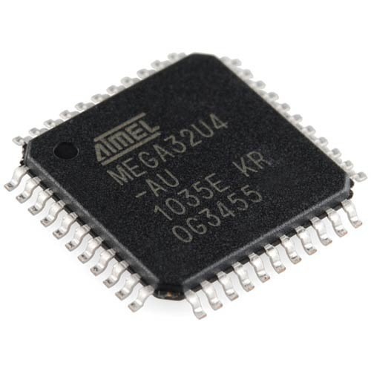

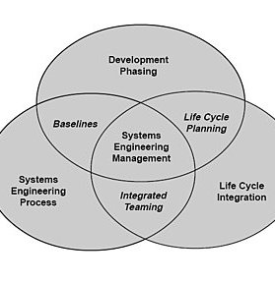
BRAINS
MICROCONTROLLER
LANGUAGE
SYSTEM
ATMEL
INTEL
CPP
PYTHON
REAL-TIME SYSTEM
EMBEDDED SYSTEM

Slide 7
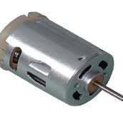
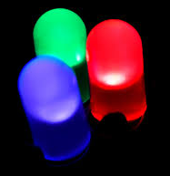
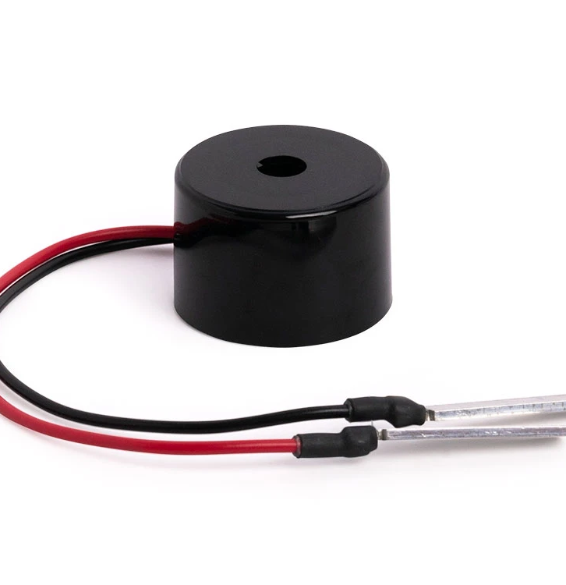
BRAWNS
MOTOR
LIGHT
SOUND
TO MOVE
TO SEE
TO HEAR

Slide 8
PROBLEM
DIAGNOSTICS!
Notes:
Even systems have their own problems, namely bugs.
Where they cannot function in optimum performance.
Ideally, they would function 100% but real-life factors such as the condition of the weather, the condition of the hardware blablabla
Also if there are problems with its coding as such they will need to rewrite it to function better
I haven’t personally encounter coding problems that would result in explosion, like the picture, but I have burnt a few components from wrong wiring and overloading hahah kinda fun to be in so much focus and then suddenly, burnt smell

Slide 9
OTHERS
THERE ARE MORE ON EMBEDDED SYSTEMS THAN YOU MIGHT NOT KNOW OF.
Notes:
Other embedded systems examples are those that have brains and are performing functions
Examples are our mobile phones, remote TV controller, headphones, cars, traffic lights – to name the least

Slide 10
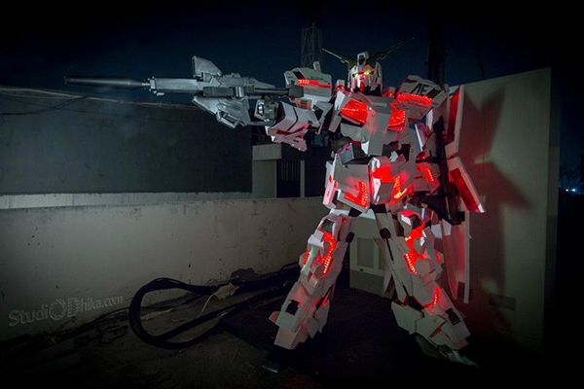
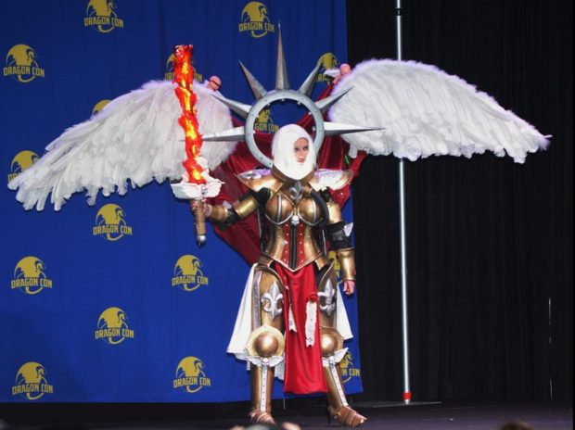
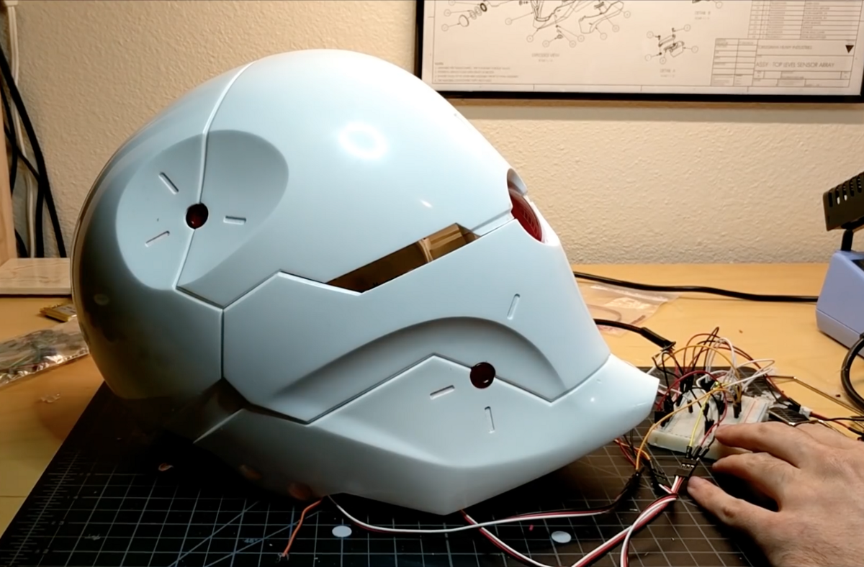
PICS
Notes:
First pic by Marchese
Second pic by a Japanese cosplayer
Third pic by Diego Valdes

Slide 11
LEADING COUNTRIES
RUSSIA
1
2
UNITED STATES
3
IRAN
Notes:
- Leading countries that produces engineer

Slide 12
THANKS
Do you have any questions? addyouremail@freepik.com 620 421 838
Please keep this slide for attribution

